Slide 1




Special Educational Needs Information Report 2025-2026
How we support children with special education needs and disabilities.
SEND is everyone’s responsibility with all teachers are teachers of SEND allowing pupils to let their light shine!

Slide 2


Welcome to Waseley Hills High School’s SEND Information report.
This report can be looked through page by page or use the ‘quick links’ later in the report to find answers to a specific question.

Slide 3
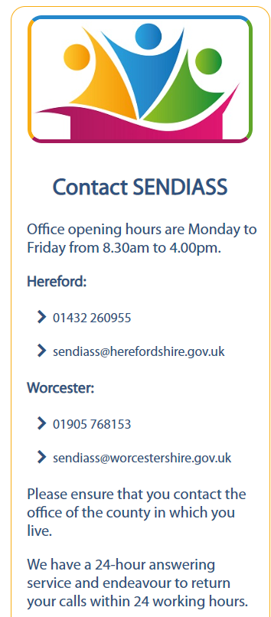

We work alongside the Worcestershire County Council / Worcestershire Children First Local Offer: SEND Local Offer | Worcestershire County Council. A video is also here: https://youtu.be/LyEo2FySJiQ
If you need any other help and support, please contact SENDIASS: Special Educational Needs and Disabilities Information and Support Services: SENDIASS Worcestershire and Herefordshire (hwsendiass.co.uk)

Slide 4
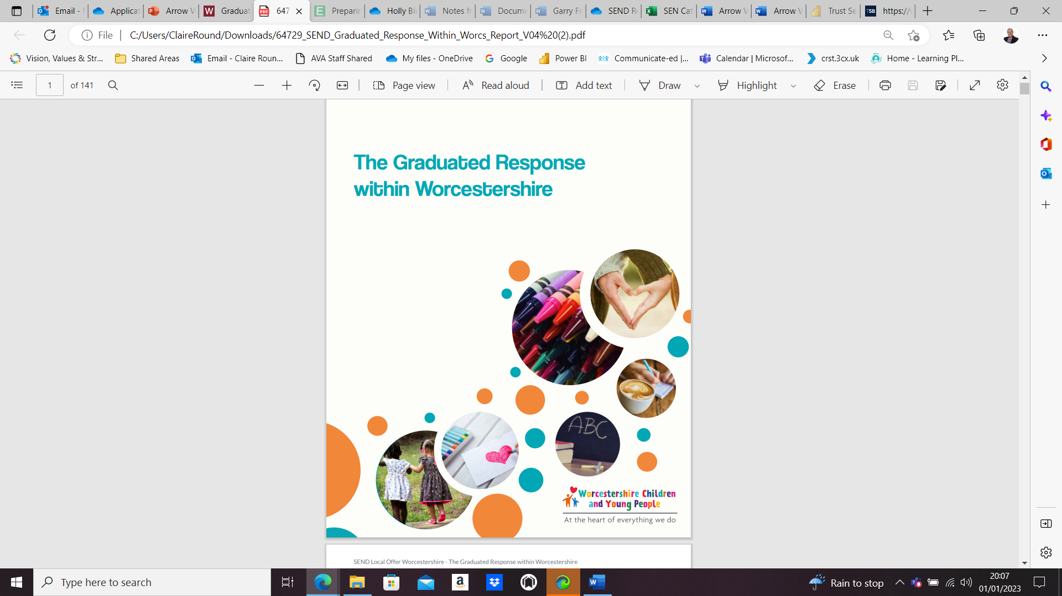

Worcestershire Graduated Response:
SEND Support Services Telephone: 01905 845579
Graduated Response (SEND support in education provision) | Worcestershire County Council
At Waseley Hills High School we are committed to working together with all members of our school community, and have produced this document with pupils, parent/carers, specialist external support and our staff
We welcome any feedback and any suggestions for involvement in this offer, so please do contact us, and make an appointment. If you think your child may have a learning barrier / special educational need or disability, please speak to / contact:
  Alis Craciun – SENDCo: acraciun@waseleyhills.worcs.sch.uk
  Ellie Meredith – SLT SEND Link: emeredith@waseleyhills.worcs.sch.uk

Slide 5
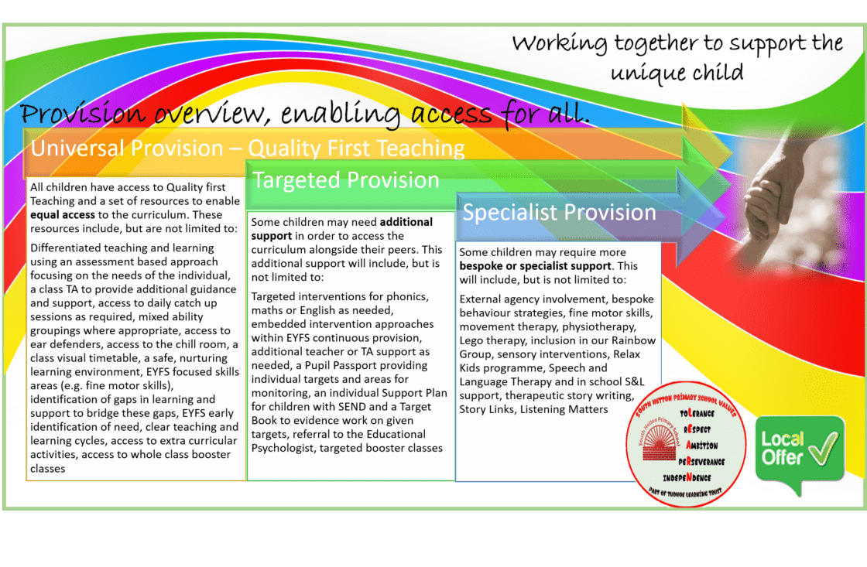

The Graduated Approach explained:

Slide 6
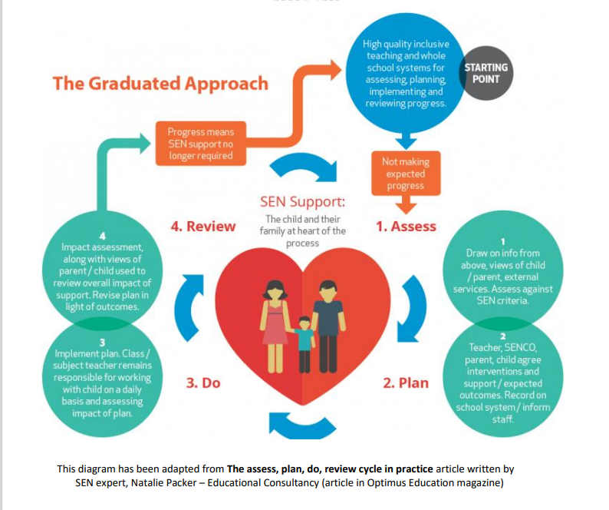

Assess
Plan
Do Review

Slide 7

Safeguarding at Waseley Hills High School
Safeguarding and SEND: Keeping children safe in education 2025
Children with special educational needs, disabilities or health issues (pages 50-51)
199. Children with special educational needs or disabilities (SEND) or certain medical or physical health conditions can face additional safeguarding challenges both online and offline. Governing bodies and proprietors should ensure their child protection policy reflects the fact that additional barriers can exist when recognising abuse and neglect in this group of children. These can include:
assumptions that indicators of possible abuse such as behaviour, mood and injury relate to the child’s condition without further exploration
these children being more prone to peer group isolation or bullying (including prejudice-based bullying) than other children
the potential for children with SEND or certain medical conditions being disproportionately impacted by behaviours such as bullying, without outwardly showing any signs
communication barriers and difficulties in managing or reporting these challenges
cognitive understanding – being unable to understand the difference between fact and fiction in online content and then repeating the content/behaviours in schools or colleges or the consequences of doing so.

Slide 8
Safeguarding at Waseley Hills High School
Safeguarding and SEND: Children with special educational needs, disabilities or health issues (pages 50-51)
Keeping children safe in education 2025
200. Any reports of abuse involving children with SEND will therefore require close liaison with the designated safeguarding lead (or deputy) and the SENDCo or the named person with oversight for SEND in a college.
201. Schools and colleges should consider extra pastoral support and attention for these children, along with ensuring any appropriate support for communication is in place.
202. Further information can be found in the department’s:
SEND Code of Practice 0 to 25 years, and
Supporting Pupils at School with Medical Conditions. And from specialist organisations such as:
The Special Educational Needs and Disabilities Information and Support Services (SENDIASS) – SENDIASS offers information, advice and support for parents/carers and carers of children and young people with SEND. All local authorities have such a service: Find your local IAS service (councilfordisabledchildren.org.uk)
Mencap – Represents people with learning disabilities, with specific advice and information for people who work with children and young people.

Slide 9
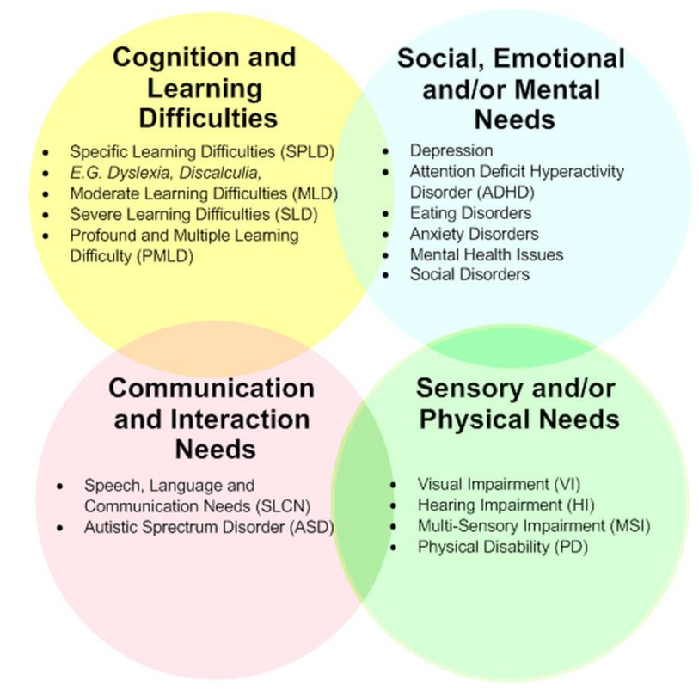

What are the 4 broad categories of SEND need in the Code of Practice 2015?

Slide 10
Areas of Special Educational needs – SEMH: Social Emotional & Mental Health
SEMH – SOCIAL, EMOTIONAL & MENTAL HEALTH - Liaison with SAFEGUARDING TEAM essential
This can manifest in many ways like being withdrawn, isolated, displays of challenging, disruptive, or disturbing behaviour. All may reflect underlying mental health difficulties and challenges such as low mood, anxiety, depression, self-harm, substance misuse, eating disorders, disaffection and antisocial behaviour.
There are other disorders such as attention deficit disorder (ADD), attention deficit hyperactive disorder (ADHD), attachment disorder and oppositional defiance disorder (ODD). These difficulties will interfere with their own ability to learn effectively, interact with others, but also cause disruption (low to high level, be unpredictable) to the learning of other students, and the teaching being delivered. Conforming to behaviour codes / expected socialisation, interpersonal skills will be challenged.
Triggers may be also linked to home situations, family communication/domestic breakdown (divorce, bereavement, unemployment, homeless), early years trauma or acute childhood experiences, refugee, asylum seeker, LAC, gender transformation www.worcestershire.gov.uk/emotionalwellbeingtoolkit N.B. Persistent disruptive or withdrawn behaviours do not necessarily mean that a student has SEN.
*All page references sourced from LA document: https://www.worcestershire.gov.uk/graduatedresponse

Slide 11
Areas of Special Educational needs – Sensory & Physical Needs
MEDICAL: A medical need or disability does not necessarily imply a SEN need – but it can still be a significant barrier / have impact on / to learning, achievement and participation. Children & Families Act 2014 place a duty to support students at school with medical conditions
➢ Individual Health Care Plan: Asthma, Diabetes, Arthritis, Epilepsy, severe allergies, Incontinence, Eczema, Cystic Fibrosis, Pregnancy, Tumour, Cancer, Tracheotomy, Colostomy, Ileostomy and Chronic Fatigue Syndrome / ME
➢ Medical Needs will need an Individual Health Care Plan: http://medicalconditionsatschool.org.uk
➢ See Supporting pupils at school with Medical Conditions DfE (2015) and Policy on school website https://assets.publishing.service.gov.uk/government/uploads/system/uploads/attachment_dat a/file/803956/supporting-pupils-at-school-with-medical-conditions.pdf
➢ Accessibility Plan updated / reviewed – see website
➢ Training Needs / information updated / reviewed / booked
PHYSICAL DIFFICULTY / DISABILITY: A condition that hinders them from (as early as pre-school) using facilities generally provided for their peers, may need adaptive specialist equipment / moderate adaptations e.g., Cerebral Palsy.
Other students will have accidents, emergency surgery or break limbs that will require extended absence / adaptive equipment like a cast and/or crutches.
*All page references sourced from LA document: https://www.worcestershire.gov.uk/graduatedresponse

Slide 12
Areas of Special Educational needs
– Sensory & Physical Needs
VI – Visual Impairment: (mild/moderate partial sight to total blindness – usually permanent (severe), can affect mobility around school, depending on functional vision capabilities. Colour blindness / visual stress > coloured overlays. Cerebral Vision Impairment, Perceptual difficulties (inability to perceive, integrate and recall visual stimuli), Mild Sensory loss. Most will have glasses with different thickness of lenses.
HI – Hearing Impairment: (mild to profound; temporary to permanent) – can cause learning delay / reduced curricular access. History of ‘glue ear’ (temporary) to a long-term conductive (middle ear) loss (bilateral or unilateral – hearing loss in one ear & good in the other ear or sensori-neural (inner ear) in origin > moderate; severe to profound. Hearing aids / cochlea implants. Can link to a dual barrier in SLCN Ref: National Deaf Children’s Society: https://www.ndcs.org.uk/. Auditory Neuropathy Spectrum Disorder MSI – Multi-Sensory Impairment (combined visual and hearing)

Slide 13
Cognition and Learning
This is when any student has a specific or delayed learning difficulty associated with processing and understanding.
Support for a wide range of learning difficulties may be required when students learn at a slower pace than their peers.
MLD: Moderate Learning Difficulties acquiring basic numeracy and literacy skills
SpLD: Specific Learning Difficulties (one or more aspect of learning e.g.,, dyslexia, dyspraxia, dyscalculia, dysgraphia)
SLD: Severe Learning Difficulties (associated difficulties with mobility and communication) PMLD – profound and multiple learning difficulties (severe and complex learning difficulties as well as a physical disability or sensory impairment).

Slide 14
Communication and Interaction (ASD)
This is when any student has difficulty with a limited awareness of social communication skills and understanding and/or interaction.
The Autism Spectrum usually shows difficulty in understanding:
Social interaction:
  Situations
  emotional expression
  Feelings
  Intentions
  reciprocal relationships
Using communication and language
  verbal / non-verbal
  expressive and/or receptive
  literal understanding
How information is processed:
  routine
  rules
  planning
  personal memory,
  rigidity and inflexible thinking
How to predict the unfamiliar after sudden change
Differences in the way sensory information is processed – can lead to extreme stress and anxiety / rejection of body contact
  over sensitivity e.g., lighting, smells, sound
  under sensitivity e.g., pain threshold, body awareness, hunger Substantial anxiety in other settings (e.g., home)
Strengths:
  in factual memory
  personal areas of interest (exceptionality)
  concrete tasks

Slide 15
Communication and Interaction (SLCN)
Speech Language and Communication Needs are defined by difficulty communicating with others (COP 6.28)
Speech
Sounds used accurately to build up words
Processing speech sounds
Fluency Language
Speaking (expressive), using words to convey meaning
Understanding (receptive), processing and making sense of what people say
Communication
The way people use language to interact – speaking and listening
Using language for different purposes and situations to question, to clarify, to describe, to debate
Non-verbal: eye contact, turn-taking, gestures and body language
Also includes Speech & language delay, impairments or disorders
Worcestershire SLCN Pathway

Slide 16
Page 1 Quick links:
What should I do if I think my child has Special Educational needs?
How does the school know if a child needs extra help?
How will both school and I know how my child is doing?
How will school help me support my child’s learning?
How will the curriculum be matched to my child’s needs?
How are the school’s resources allocated and matched to chi...
How will the school decide the type of support my child wi...
How does the school judge whether the support has had an ...
How will my child be included in activities outside the c...
What support will there be for my child’s overall well be...

Slide 17
Page 2 Quick links.
What training have the staff supporting SEND had or what ...
How accessible is the school both indoors and outdoors?
How are parents/carers involved in the school? How can I get inv...
How do children contribute their views about their support...
What specialist services are available or can be accessed...
How will the school prepare and support my child when tra...
Who can I contact for further information or to complain ...
The Local Offer
School Contact details:
What other support services can help me?

Slide 18

What should I do if I think my child has Special Educational needs?
The Code of Practice (2015) defines SEN as: ​
A child or young person has SEN if they have a learning difficulty or disability, which calls for special educational provision to be made for them. ​
​
A child of compulsory school age or a young person has a learning difficulty or disability if they: ​
(a) Have a significantly greater difficulty in learning than the majority of others of the same age; or ​
(b) Have a disability, which prevents or hinders them from making use of educational facilities of a kind generally provided for others of the same age in mainstream schools or mainstream post-16 institutions. ​
​
At Waseley Hills High School if a learner is identified as having SEN, provision that is ‘additional to or different from’ the normal personalised, adjusted and inclusive curriculum, we will begin to overcome the barrier to their learning through a Graduated Response Approach (previously explained).​
​
Please contact us: 0121 453 5211
Mrs Alis Craciun– SENDCo
Acraciun@waseleyhills.worcs.sch.uk
Return to ‘quick links’

Slide 19

How does the school know if a child needs extra help?
When a student continues to make less than expected progress, despite support and interventions that are matched to their area of need, we will consider involving specialists or external agencies Wave 2 Targeted / Wave 3 bespoke interventions. ​
Whenever we think specialists should be involved, we seek parent/carer permission first. Following a meeting or assessment with a specialist we will share what was discussed and/or agreed with the parent/carer and teachers of the student, through an individualised .
​
When a student needs more specialist help there is a Directory of Agencies used by the school, that is referred to for Wave 3 specialist intervention ​
e.g., SEND Supported (Autism and Cognition & Learning);​
Chadsgrove (Physical Disability) ​
CAMHs & CAMHs CAST/Spa (Mental Health) ​
SENDIASS (Post 16 Advice and Guidance)​
Umbrella Pathway (assessment for ASD)​
SALT (Communication & Interaction/Speech & Language) ​
Community Paediatrics (assessment for ADHD)
Return to ‘quick links’

Slide 20

How will both school and I know how my child is doing?
Monitoring takes place in many forms and all subject teachers are responsible for the progress of any student with SEND.
This monitoring can take place in many forms: ​
➢ Lesson Observations ​
➢ Observations of students – their work / book scrutiny / learning walks ​
➢ Marking and feedback: Key assessment data sent out throughout the year​
➢ Link Meetings by SLT with DLS/HOY/YTL ​
➢ Student and parent/carer / staff evening meetings – reports as required – with positive and structured conversations. ​
➢ Trusted Adult monitoring and communication​
Meetings available as and when needed
Annual Reviews for EHCP pupils
Reports issued with specific interventions e.g. BRSP and Paired Reading
Return to ‘quick links’

Slide 21

How will school help me support my child’s learning?
Arbor is an online App, for parents/carers, staff and students - which will aid communication. Messages and school letters are sent via the app.
​
Regular communications home – form tutors, heads of year / meeting requests as required – please contact the school​
​
Website- Curriculum maps and information of parental support groups, mental health and well-being support, SEND Supported parental consultations and support​
​
Team Around the Child meetings in school – leading to an individual provision passport that outlines strategies for teaching staff​
​
Community Coffee morning invites – for all parents/carers with children and young people with SEND
Parental Workshops – Autism workshops, ADHD workshops, Exam anxiety and Exam Access Arrangement workshops.
Return to ‘quick links’

Slide 22

How will the curriculum be matched to my child’s needs?
At Waseley Hills High School we endeavour to ensure each student with SEND gets the quality teaching and support they need.
Subject teachers are responsible for the progress and development of students in their class, including the support given by Achievement Assistants or external agencies. Each subject has a curriculum map
Every teacher is required to adapt the curriculum to ensure access to learning for all children in their class. The National Teacher Standards 2012 detail the expectations on all teachers. High quality personalised teaching, adjusted for student’s needs, is the first way we respond to students who have SEND or any learning barrier
Additional intervention and support cannot make up for a lack of good/outstanding teaching. To support this, teaching at Waseley Hills is regularly reviewed. We have a thorough teacher and support staff CPD training programme to ensure teachers’ understanding of strategies to support and identify vulnerable students and their knowledge of SEND is up to date. When a student is identified as having SEND, we use a four-step process to ensure barriers to learning are removed and effective provision is put in place. This process is known as the ‘Graduated Approach’
The Assess, Plan, Do, Review Cycle ensures that students’ and parents/carers’/carers’ needs are at the centre of all provision provided by a “Team around the Child” approach
Return to ‘quick links’

Slide 23

How are the schools resources allocated and matched to children’s special educational needs?
Waseley Hills receives a ‘notional budget’ funding directly to the school from the local authority to support the needs of all learners with SEN & Disability. ​
Pupils with an EHCP may have High Level Needs funding attached to their provision​
Costed provision mapping evidenced through the graduated approach can be submitted to the Local Authority which, if successful provides ‘top up funding’ for resources for learners who require support that exceeds that originally available to the school.​
All Departments have a budget to provided resources appropriate to need
For specific projects Waseley Hills SEND department will prepare bids for external funding e.g. 2022/23 a successful bid was made to Shelia Coates to help expand and develop Waseley Hills Autism provision.
Return to ‘quick links’

Slide 24

How will the school decide the type of support my child will receive?
At Waseley Hills each student’s current skills and level of attainment are assessed during the academic year (e.g., NGRT (Reading Test) / DASH Free Writing / Dyslexia Screener/ PASS survey / WRAT 5 (spelling assessment).
Through regular key assessment data collections and monitoring we can identify students who are making less than expected progress for their age and individual circumstances.
If a learner is identified as having SEND, provision that is ‘additional to or different from’ the normal personalised, differentiated and inclusive curriculum, will begin to overcome the barrier to support to their learning through a Graduated Response Approach. Learners can fall behind in school for lots of reasons. This may be because their progress is a result of:
  Gaps in their learning following a prolonged absence from school e.g., medical, personal, social, emotional, or attending from a different school > catch up support and interventions provided
  Developmental delay - significantly slower than that of their peers starting from the same point > adjusted high quality teaching support
  They may not speak English very well or at all > language acquisition support
  They may be worried about different things that distract them from learning – bereavement, home circumstance, young carer, child looked after – emotional well-being and virtual school support
Return to ‘quick links’

Slide 25

How will the school decide the type of support my child will receive?
The PASS (Pupil Attitudes to Self and School) Survey – identifying attitudes to school and emotional well-being may lead to participation in the ELSA or Talk About for Teenagers programme, enabling self-esteem, self-confidence, positive attitude support
Class teachers, form tutors, support staff, parents/carers/carers and the learner themselves will be the first to notice a difficulty with learning. At Waseley Hills we ensure that assessments directly involves the learner, their parents/carers/carer and of course their teacher. The Special Educational Needs Coordinator will also implement personalised support following the identification of specific barriers to learning.
We have a range of assessment tools available alongside the advice and input of numerous external agencies and services for alternative and appropriate 'Progress' pathway curriculum delivery, exam access arrangement support and provision off-site if needed
For some learners we may want to seek advice from specialist teams. In our school we have access to various specialist services. We have access to services universally provided by Worcestershire Children First / Local Authority which are described in their Local Offer.
Return to ‘quick links’

Slide 26
How does the school judge whether the support has had an impact?
At Waseley Hills we have rigorous assessment procedures to ensure we are keeping track of student progress throughout their time with us. Two to four times a year parents/carers will receive a key assessment report on their child’s progress. parents/carers of students who are identified as having an EHCP will be invited into school to talk about their child’s targets and review the progress they are making towards them. These meetings will be based around scheduled meetings planned in school such as parents/carers’ Evenings.
At least once a year, parents/carers of students with an EHCP will be invited into school to attend their CYP Annual Review. If the student has a Trusted Adult/Form Tutor liaison with home will be as needed/required. The whole school systems of SIMS and internal data analysis allow knowledge of progress and impact towards outcomes at any time.
Directors of Learning & Standards/Heads of Year& Year Team Leaders monitor students within their subject areas and SEND Team closely monitor all students with an EHCP.
Progress data of all learners is collated by the whole school and monitored by DLS / Senior Leadership Team and termly meetings with Governors
Return to ‘quick links’

Slide 27

How will my child be included in activities outside the classroom including school trips?
At Waseley Hills High School we work hard to ensure that students with SEND engage in all the activities of the school alongside students who do not have SEND. We will try to make sure that students with any additional needs are able to take part fully in school visits and events. We pride ourselves on being an inclusive school, which allows all pupils to ‘let their light shine’.
In addition to the school curriculum, many subject areas run educational visits to enrich the experiences our students have, locally, regionally, nationally and internationally. The school also runs enrichment programs and activities during lunchtimes and after school where all students have the opportunity to broaden their experiences outside the curriculum.
No student will be excluded from extra-curricular activities on the basis of SEND. A risk assessment will be produced by the activities Lead Teacher which will outline how the needs of all pupils will be met. Pupil and parent voice, for pupils with specific barriers will be used to help inform the Risk Assessment.
Return to ‘quick links’

Slide 28

What support will there be for my child’s overall well being?
Staff run many interventions from personalised to small group work. e.g., self-esteem, social skills, emotional well-being, self-harm, positive self-image sessions (to name a selection) for students identified / referred by HOY / YTL / SLT / Form tutors. ➢ The Pastoral and Learning support teams provide daily support for those students who need “a chat”​.
​
For Safeguarding / Child protection issues. members of school staff are Designated Child Protection / CSE trained officers. Learning Support continually liaise with the safeguarding team. Extremism and Radicalisation are also monitored​
➢ Specialist External Agencies/ Health Care Professionals also support students as required. ​
➢ Each student has a Form Tutor / Head of House / Year Team Leader who they can speak to whenever required. We also do a 'meet and greet' welcome for some of our most vulnerable​
➢ The SENDCo, HLTAs and Head of Year Inclusion, regularly refer, contact and attend CAMHs CAST discussions, and liaise with WEST / Reach 4 Wellbeing as required to support students, parents/carers and carers. ​
➢ Supported Home Visits for attendance ​
➢ Alternative provision placement visits​
➢ Discussions with Family GPs / named medical professionals as relevant ​
➢ Referrals to the Umbrella Pathway as relevant ​
➢ PCSO link support available as required ​
➢ Learning Support is available for students during break, lunch and after school board game club
➢ Emotional Wellbeing support personalised s to ensure holistic approach to education​
Return to ‘quick links’

Slide 29

What training have the staff supporting SEND had or what are they having?
The school SEND Team will ensure that all staff are aware of students’ specific special educational needs. All students on the SEND register will have a that is shared with staff.
Student’s s are written and distributed to provide strategies for teaching and support staff to ensure that the appropriate support is put in place.
There is a full programme of CPD training for all staff to participate in and specific training is identified through the Performance Management process. Training Days are used for whole school, department and individual SEND training when identified. This thorough training programme ensures Governors and teachers understand the strategies to support and identify vulnerable students and their knowledge of SEND is up to date. This training is run by school staff and outside speakers with specialist experience as well as by external agencies.
Achievement Assistants work with teaching staff to ensure that students with SEND can access the curriculum.
Exam Access Arrangements: Annual training for Invigilators and Achievement Assistants (taken by the Exam Manager)
Training delivered by external agencies e.g. WCF VI team
Time is allocated each term for a regular CPD update to staff by the Curriculum and Pedagogy & Learning Support Dept. This may include a focus on a teaching & learning need, scaffolding, adjusted teaching, a particular barrier or student need reminder/consistency of practice, or exam access requirement information/training.
EVAC Chair training is completed annually
Return to ‘quick links’

Slide 30

How accessible is the school both indoors and outdoors?
Although our Accessibility Plan is updated formally every 3 years, it is a working document written by staff, parent/carers, and pupils with any access or medical need.​
​
Main teaching buildings have ramp access to allow access to all pupils. Where school buildings have teaching on more than 1 floor a lift is in place to allow access to all pupils. This enables all students with any access need to be or to increase their independence in preparation for adulthood post school.​
​
Our accessibility plan can be found on our school website.
Policies | Waseley Hills High School
Return to ‘quick links’

Slide 31

How are parents/carers involved in the school? How can I get involved?
Waseley Hills will provide a key assessment report on progress two to four times a year. Where a student is receiving SEND/EHCP support the SEND Team will be in contact with parent/carers regularly to talk about their young persons' needs and the activities and support they will receive to help them make progress.
Parents/carers are encouraged to share all relevant information as they know their son/daughter/young person the best. These discussions will help us identify the responsibility the parent/carer, student and the school have towards the best statutory outcomes for the student. We hope that these discussions will strengthen the impact of the support we give in school by increasing engagement.
If we think a student with SEND needs extra support from / referral to outside specialists, parents/carers will always be asked for their signed permission.
Children with SEND who are also Looked After will have meetings in school in relation to their PEP (Personal Education Plan) every term. This is led by the Heads of Year and the Virtual School.
Coffee morning and workshop invites are sent out where parent/carers are given the chance to be fully involved with discussions and ideas for improvement.
To get involved – please just contact the school.
Return to ‘quick links’

Slide 32

How do children contribute their views about their support and who can help them?
Students will always be included in discussions about their needs, targets and progress through ownership of their provision mapping .
Students with SEND will always have a safe and inclusive area to go to within Waseley Hills if they are not happy or have particular worries or concerns e.g., Form Tutor – HOY, SWOs, SEND Team
Students with SEND will regularly attend interventions and social sessions in these areas and will know all the staff team very well. Students will always have someone to talk to. This will ensure their views are heard and incorporated into their targets.
SEND students:
➢ Are consulted as student voice is one of the most important decision-making processes. We have an ‘Open Door’ policy for students to speak to staff at any time about policy, process and personalised strategies.
➢ Will be asked about the accessibility plan for the whole school site
Development of a SEND school council.
Return to ‘quick links’

Slide 33

How do children contribute their views about their support and who can help them?
➢ Can express their preference for the gender of their trusted adult (Achievement Assistant) for their own personal care needs.
➢ Provide student panels for interviews, visits and tours of the school
➢ Have an opportunity to express their Student Voice prior to and during every EHCP annual review
➢ Are part of whole School Council meetings held each term or as needed.
➢ Are used as guides for visitors on Open Evening every September.
➢ Are talked to by their Form Tutors to talk about progress, achievements and to review any targets
➢ Students will be supported to review their targets on their s.
➢ Students with EHCP are set targets in line with their outcomes in these statutory documents that are monitored termly by the SEND Team who are in their classes. Formal review takes place annually
Return to ‘quick links’

Slide 34

What specialist services are available or can be accessed by the school?
SENDIASS: Special Educational Needs and Disabilities Information and Support Services
SENDIASS Careers Advice and Support
Umbrella Pathway – Autism Assessment
Community Paediatrics – SEMH ADHD Assessment
Worcestershire Children First
EHCP Assessment and consultation
Educational Psychologist
Complex Communication Team
Visual Impairment Team
Hearing Impairment Team
Independent Educational Psychologists as needed
CAMHS – Child and Adolescent Mental Health Services.
The Wellbeing and Emotional Support Teams (WEST) in schools service is designed to help children and young people ages 5-18 years access mental health and wellbeing support early on in educational settings
BETTER Education Specialists tutoring Service
EPE Psychology Team
The Forge ADHD Outreach
Return to ‘quick links’

Slide 35

How will the school prepare and support my child when transferring classes or schools?
Transition is a part of life for all learners. Waseley Hills works with schools, colleges, universities and other settings to support students through positive transitions from one educational setting to another/ phases of education and in preparing for adulthood.
If your child is moving from primary to high school, we will work with the SENDCo and class teacher/transition lead at their primary school to ensure that we understand your child’s needs and can plan for them when they move to us. Sometimes we will attend annual review meetings at primary schools and specialist service / professionals’ meetings to help us gather all the relevant information. We will also arrange extra visits to Waseley Hills to help with your child’s transition, and a specific SEND transition day is also held.
As students approach the end of their time at Waseley Hills, we work with them to ensure they have high aspirations about employment, College courses and higher/further education, independent living and participation in society. Discussions about students’ futures will focus on what they want to achieve and the best way we can support them. Helping them consider the right post-16 option is part of this planning. University visits are also arranged
Arrange/assist work experience / work-based placement & assist with travel arrangements if required
Return to ‘quick links’

Slide 36
Who can I contact for further information or to complain about SEND issues?
Dealing with complaints: a copy of the Complaints Policy is available on the school website.​
​
➢ If a parent/carer wishes to complain about the SEND provision or the policy, they should in the first instance, raise it with the SENDCo / HLTA's, who will try to resolve the situation. ​
​
➢ If the issue can’t be resolved within 10 working days, the parent can submit a formal complaint to the Principal / Chair of Governors in writing or in any other accessible format. The Principal will reply within 10 working days. ​
​
➢ Any issues that remain unresolved at this stage will be managed according to the school’s Complaints Policy. This is available from the school website.
Policies | Waseley Hills High School
Return to ‘quick links’

Slide 37
The Local Offer
For pupils who reside within Worcester please use the link below to access Worcester’s Local Offer:
SEND Local Offer | Worcestershire County Council
https://www.youtube.com/watch?v=LyEo2FySJiQ
For pupils who reside within Birmingham please use the link below to access Birmingham’s Local Offer:
Local Offer Birmingham | SEND Advice, support and Information
Please note as Waseley Hills, being a Worcester School, can not access all services outlined within the Birmingham Senar Local Offer.
Return to ‘quick links’

Slide 38
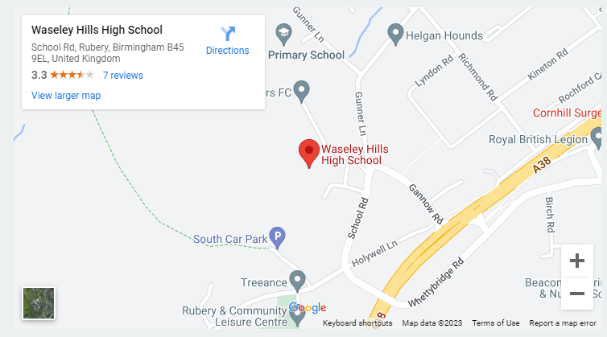
School Contact details:
Telephone : 0121 453 5211
Website: Waseley Hills High School
SENDCo email:
acraciun@waseleyhills.worcs.sch.co.uk
Return to ‘quick links’

Slide 39
What other support services can help me?
Get There | Worcestershire County Council Information and guidance for 16-25 year olds
Better Health - NHS (www.nhs.uk)
Every Mind Matters - NHS (www.nhs.uk)
Worcestershire Here4YOUth - Cranstoun
National Autistic Society (autism.org.uk)
Kooth
ADHD Foundation
Suicide prevention | Worcestershire County Council
The Dyslexia-SpLD Trust - Home
Careers Portal (skills4worcestershire.co.uk)
SEMH advice and strategies
Worcestershire Apprenticeships (worcsapprenticeships.org.uk)
Careers advice and guidance | Worcestershire County Council
Return to ‘quick links’

